Slide 1
MODULE 4:
Keys, Constraints & Relationships
MySQL

Slide 2
Keys, Constraints & Relationships
Primary Key
Foreign Key
Unique
NOT NULL
CHECK
AUTO_INCREMENT
ON DELETE / ON UPDATE
CASCADE
SET NULL
RESTRICT
Relationships
One-to-One
One-to-Many
Many-to-Many (junction tables)

Slide 3
Learning Objective
By the end of this session trainees will learn:
What keys and constraints are
Why they are important for data integrity
How to create Primary Keys, Foreign Keys
How to use UNIQUE, NOT NULL, CHECK
How AUTO_INCREMENT works
What happens with ON DELETE / ON UPDATE
Understanding table relationships
Designing One-to-One, One-to-Many, Many-to-Many

Slide 4
What are Constraints?
Definition
Constraints are rules applied to table columns to control the type of data stored.
They ensure:
✔ Data accuracy ✔ Data integrity ✔ No duplicate or invalid data

Slide 5
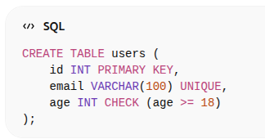
Example

Slide 6
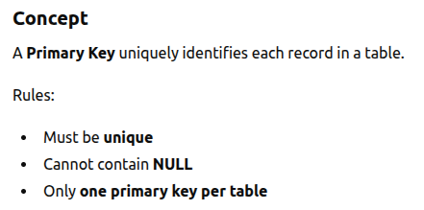
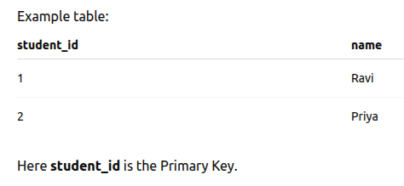
PRIMARY KEY

Slide 7
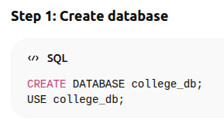
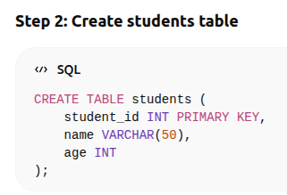
Practical Demo

Slide 8
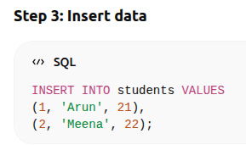
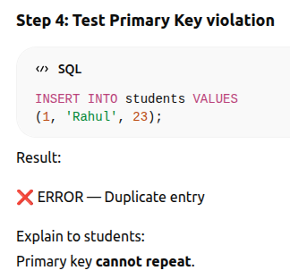
Practical Demo

Slide 9
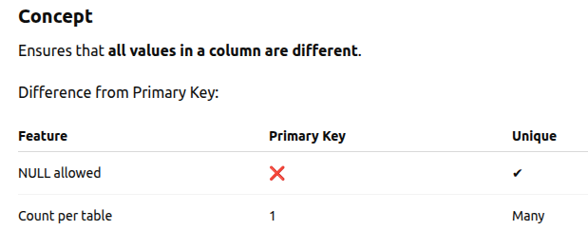
UNIQUE Constraint

Slide 10
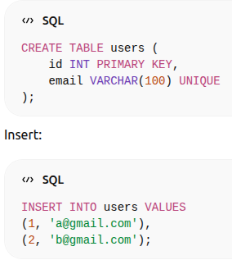
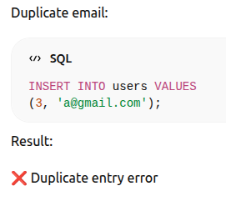
Practical Example

Slide 11
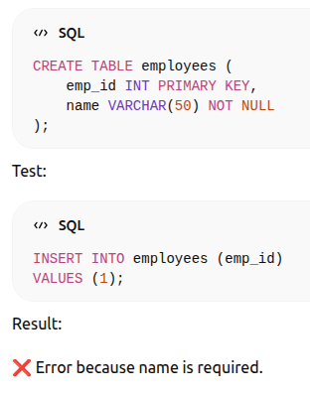
NOT NULL
Concept
Ensures that a column cannot store NULL values.

Slide 12
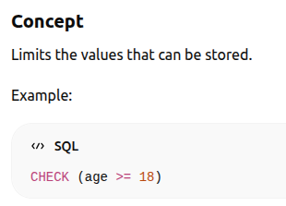
CHECK Constraint

Slide 13
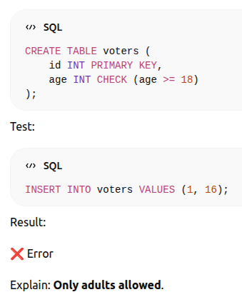
Practical Example

Slide 14
AUTO_INCREMENT
Concept
Automatically generates numbers.
Used mostly with Primary Key.

Slide 15
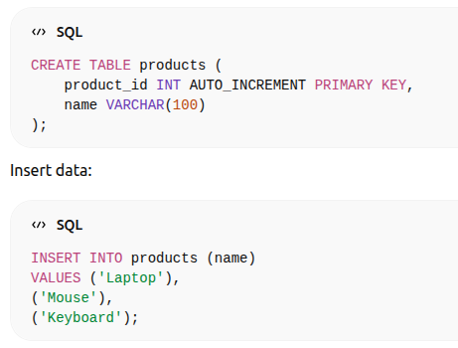
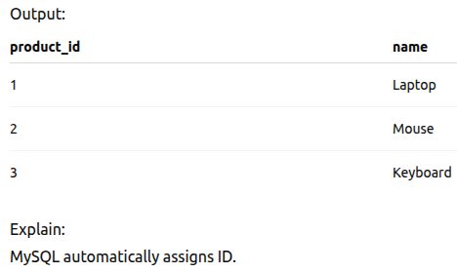
Practical Example

Slide 16
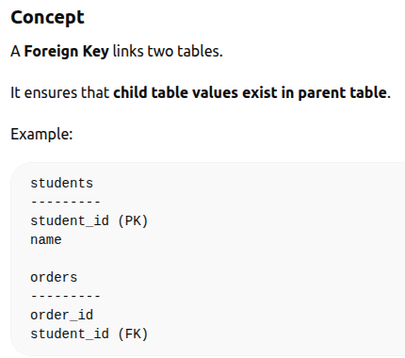
FOREIGN KEY

Slide 17
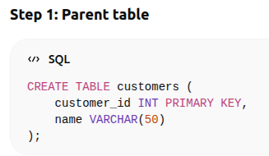
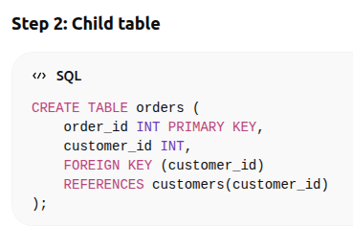
Practical Demo

Slide 18
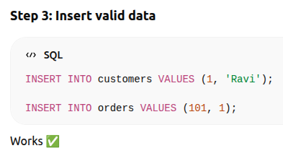
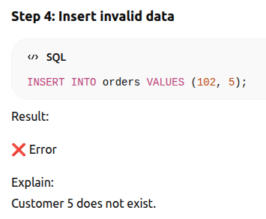
Practical Demo

Slide 19
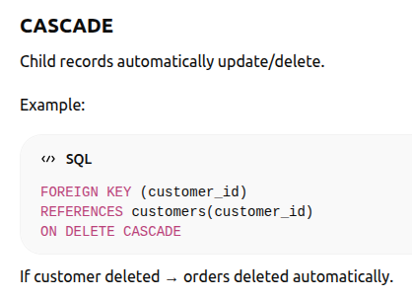
ON DELETE / ON UPDATE
These control what happens when parent table changes.

Slide 20
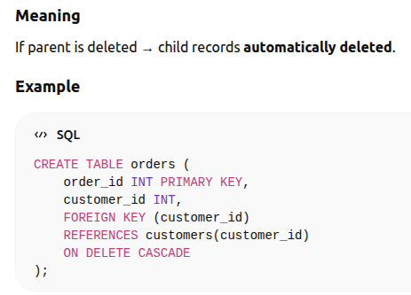
ON DELETE CASCADE

Slide 21
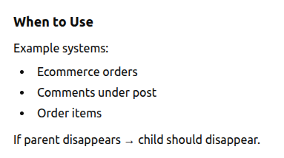
ON DELETE CASCADE

Slide 22
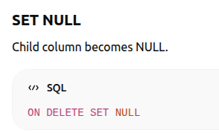
SET NULL

Slide 23
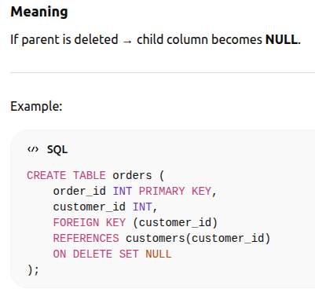
ON DELETE SET NULL

Slide 24
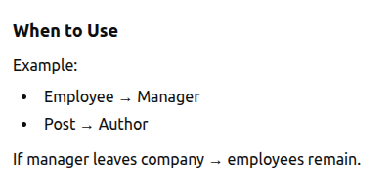
ON DELETE SET NULL

Slide 25
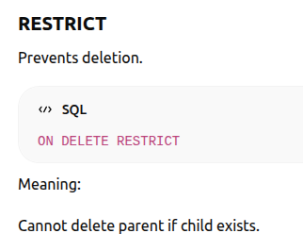

Slide 26
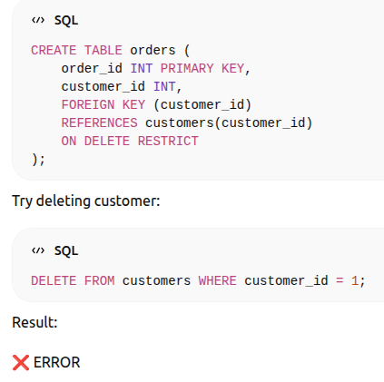
ON DELETE RESTRICT
You cannot delete parent if child records exist.

Slide 27
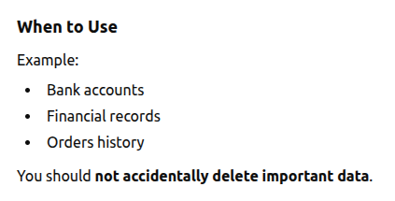
ON DELETE RESTRICT

Slide 28
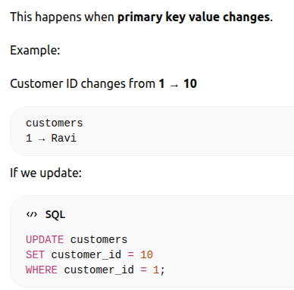
ON UPDATE

Slide 29
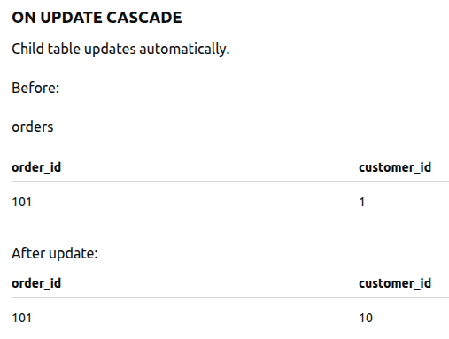

Slide 30
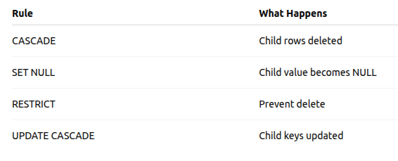
Simple summary

Slide 31
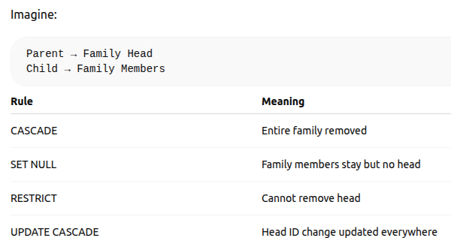
Real Life Analogy

Slide 32
Relationships
Relationships define how tables connect.
One to One
One to Many
Many to Many

Slide 33
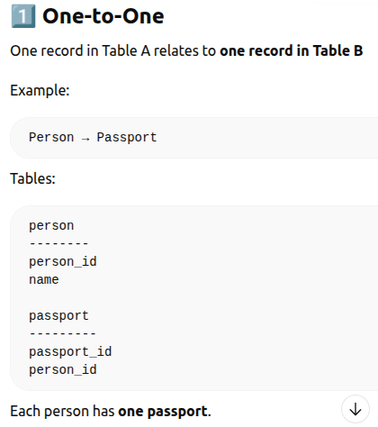

Slide 34
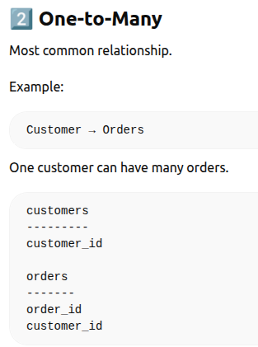

Slide 35
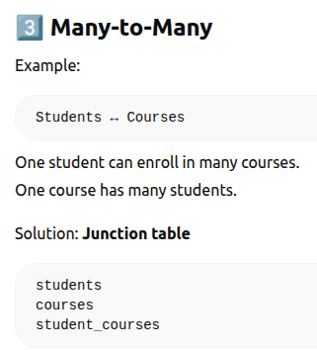

Slide 36
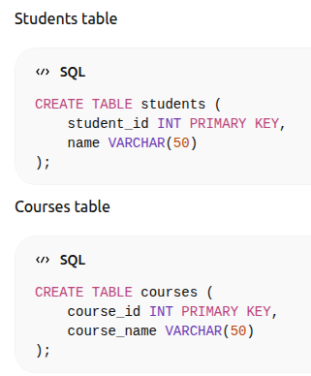
Practical Demo

Slide 37
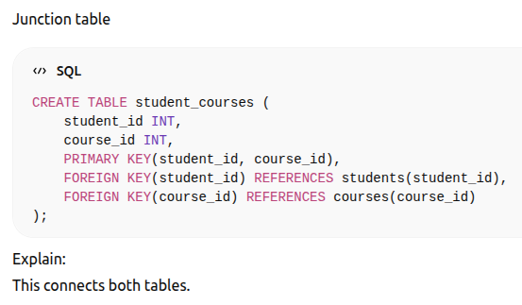
Practical Demo

Slide 38
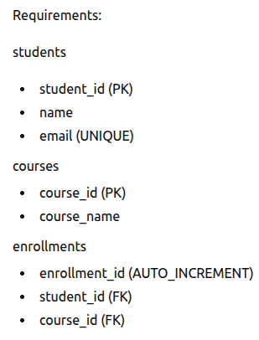
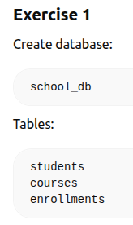
Practical Exercise for Students

Slide 39
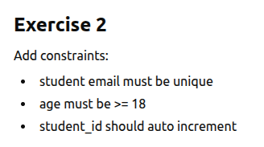

Slide 40
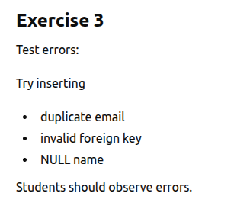

Slide 41
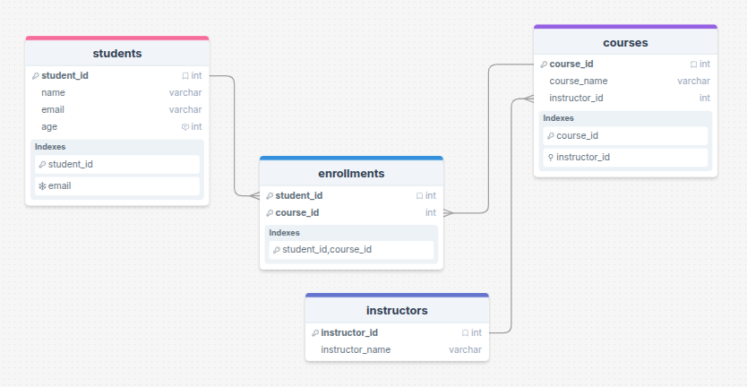

Slide 42
Any questions and doubts?

Slide 43
MCQ Test

Slide 44
Session End

